Slide 1
Field & Garden birds
Practice 2

Slide 2
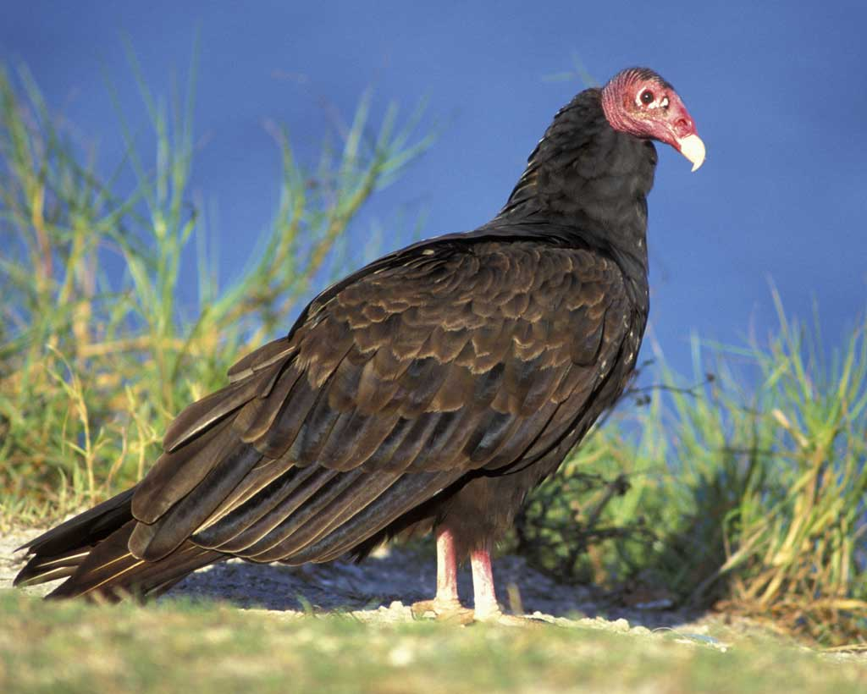

Slide 3
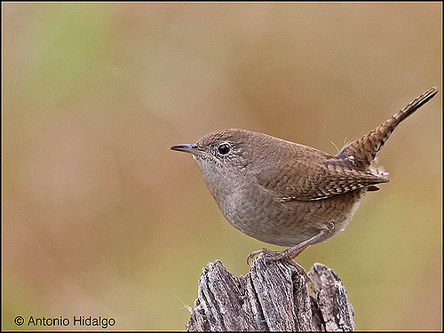

Slide 4
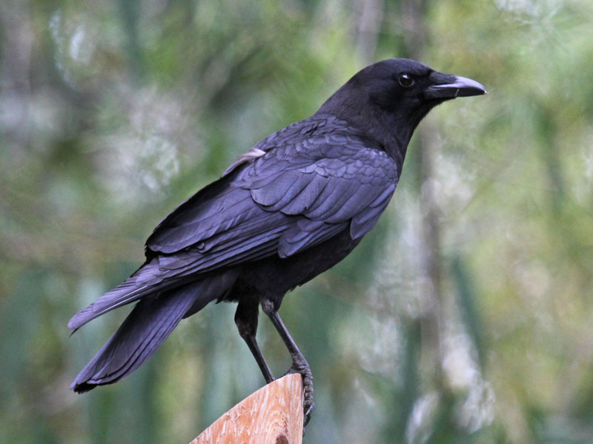

Slide 5
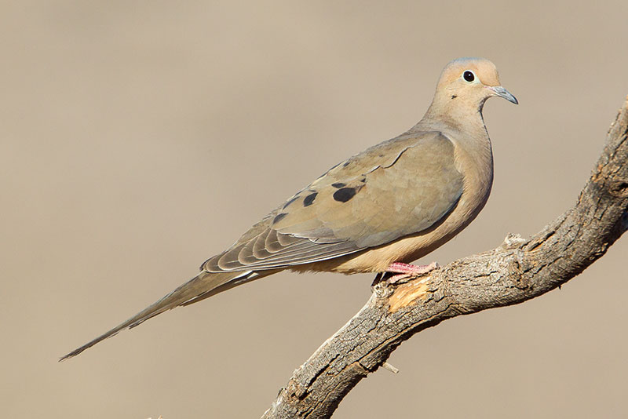

Slide 6
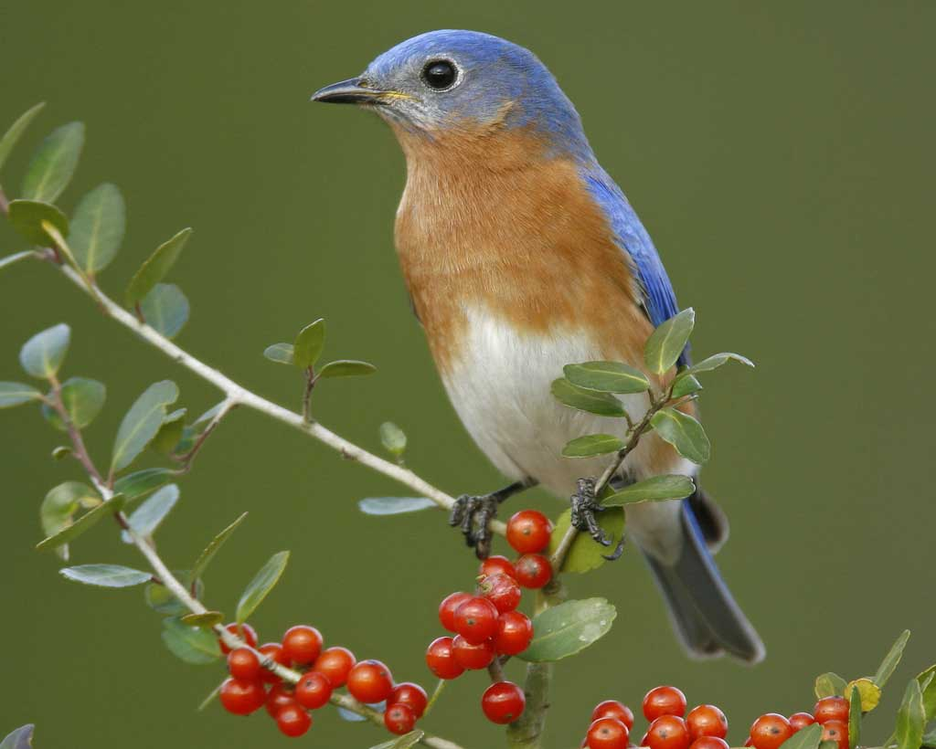

Slide 7
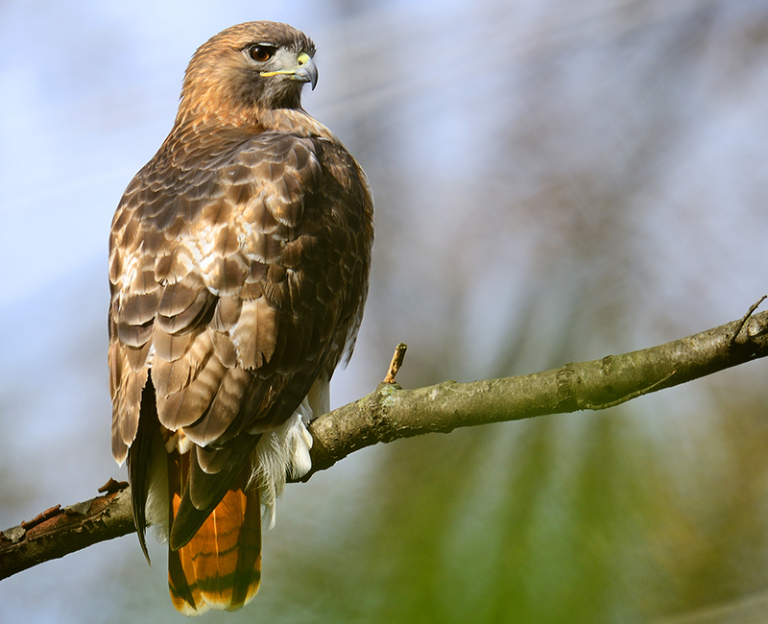

Slide 8
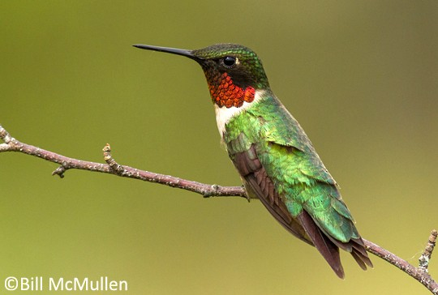

Slide 9
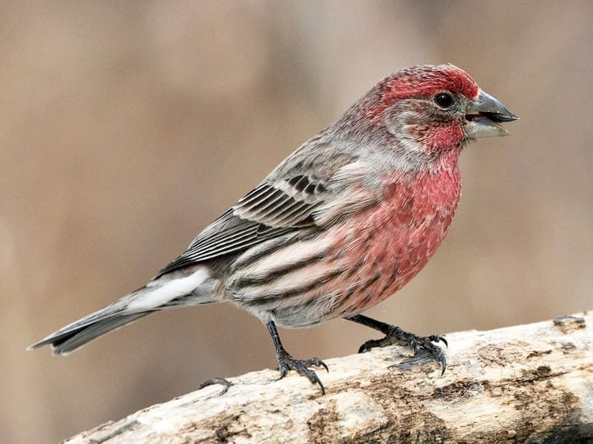

Slide 10
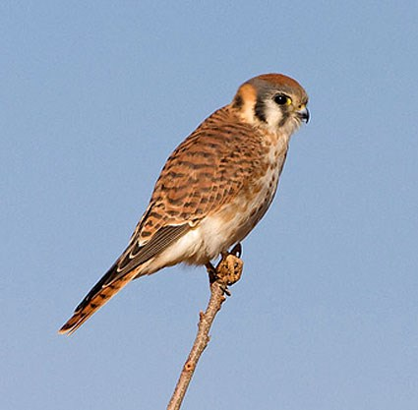

Slide 11
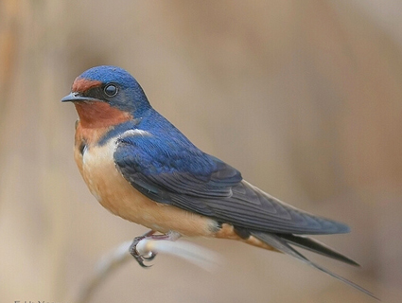

Slide 12
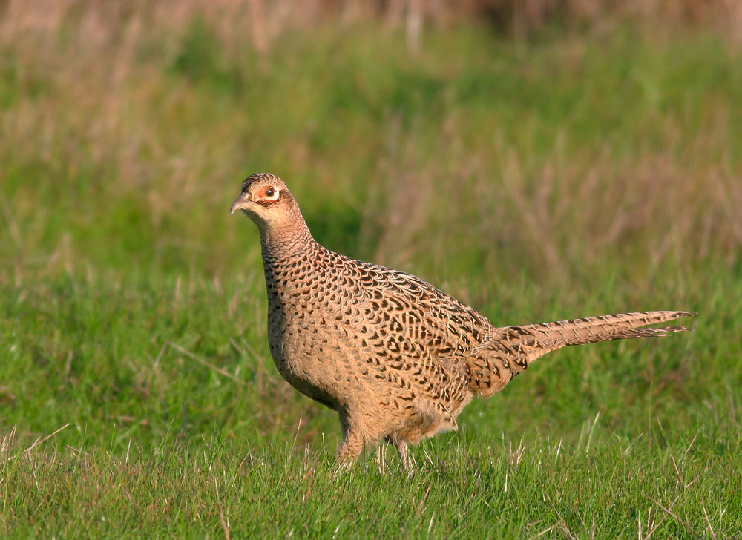

Slide 13
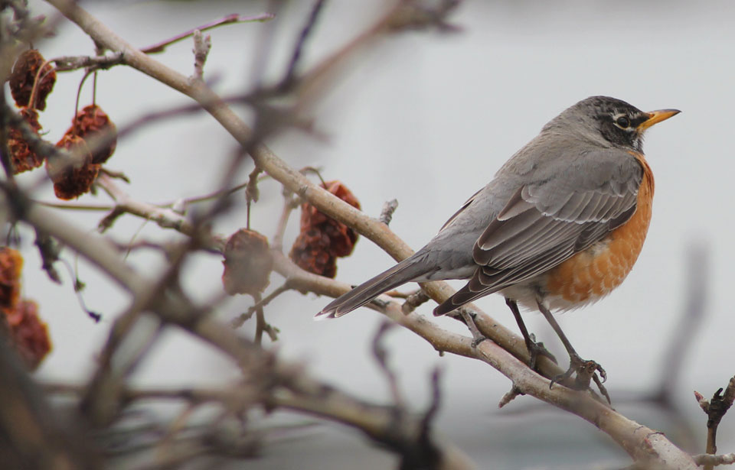

Slide 14
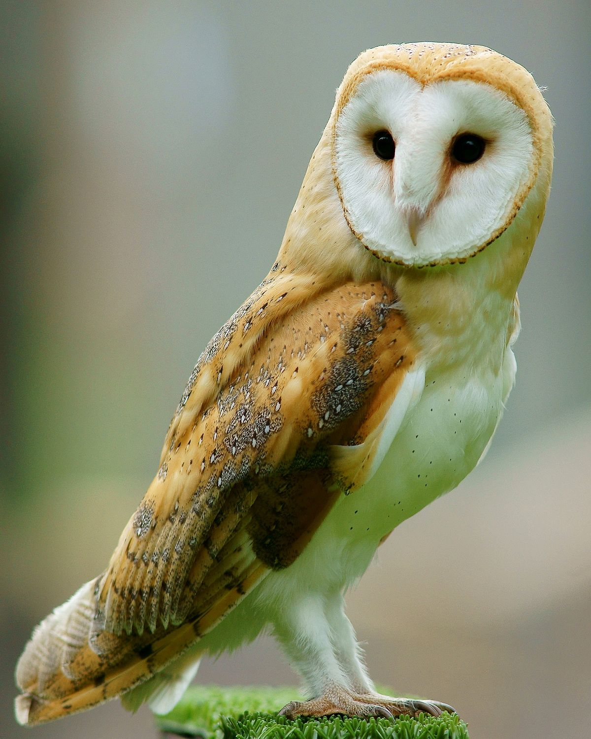

Slide 15
Answer Key
1) title slide
2) Turkey vulture
3) House wren
4) American crow
5) Mourning dove
6) Eastern bluebird (male)
7) Red-tailed hawk
8) Ruby-throated hummingbird (male)
9) House finch (male)
10) American kestrel (female)
11) Barn swallow
12) Ring-necked pheasant (female)
13) American robin (female)
14) Barn owl

